Slide 1
Young Gigs
Daksh Girdhar
Minav Karia
Vivan Jain

Slide 2
Introduction
Welcome to our presentation on Young Gigs, a cutting-edge platform transforming the landscape of job searching for the younger generation. In today’s rapidly evolving digital era, traditional job-hunting methods are being challenged by the rise of gig economy platforms. Young Gigs emerges as a dynamic solution tailored to the needs and preferences of young job seekers, offering a seamless and efficient way to connect with diverse employment opportunities.
Throughout this presentation, we will delve into the key features and functionalities of Young Gigs, explore its impact on the job market, and discuss how it empowers both employers and job seekers alike.

Slide 3
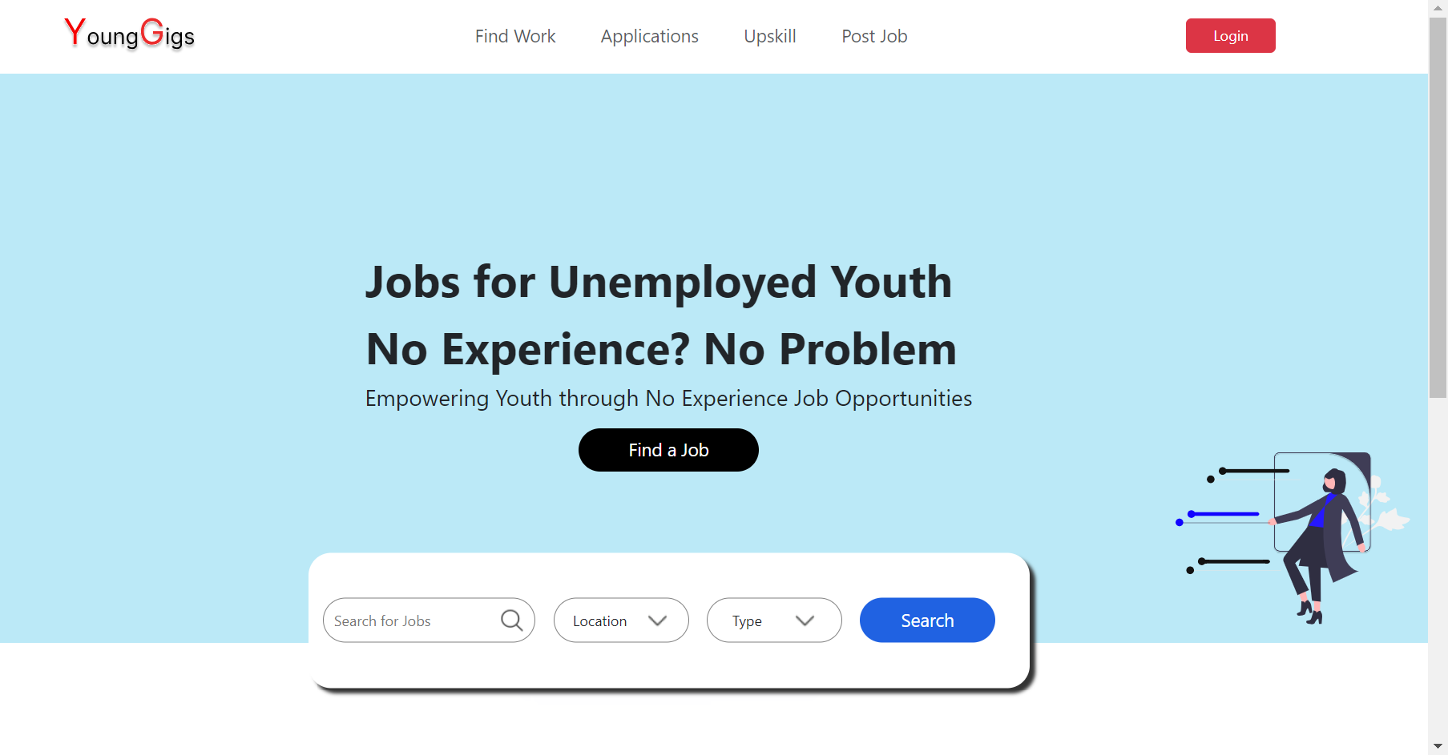
Our Webpages
Home Page

Slide 4
Feature: Home Page Experience
Description: The homepage of Young Gigs serves as the central hub for users, providing a seamless and intuitive experience from the moment they land on the platform.
Login and Signup: Users are greeted with easy access to login and signup options, allowing both new and returning users to quickly access their accounts or create new ones.
Find a Job: Job seekers can effortlessly navigate to the job search feature, where they can explore a diverse range of job listings and opportunities tailored to their preferences and qualifications.
Upskill: The homepage prominently features the Upskill option, inviting users to enhance their skills and knowledge through curated resources and educational content.
Post a Job: Employers and HR professionals can easily access the post job feature directly from the homepage, streamlining the process of posting new job openings and reaching potential candidates.
Soothing Experience: With a clean and intuitive design, coupled with smooth transitions and visual elements, the homepage of Young Gigs provides users with a calming and enjoyable browsing experience.

Slide 5

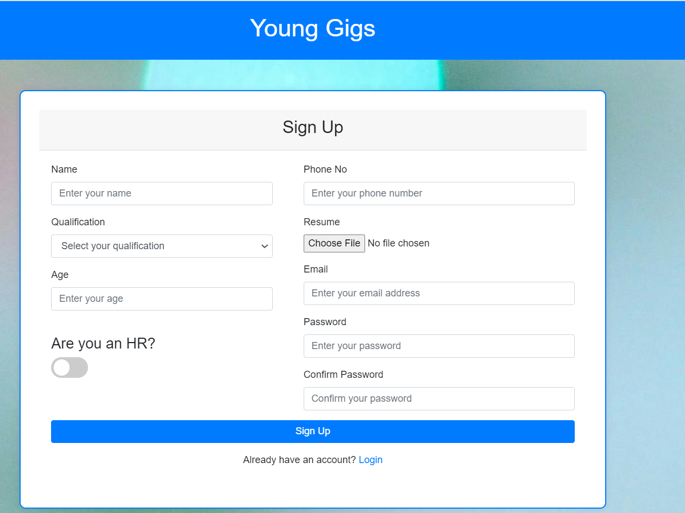
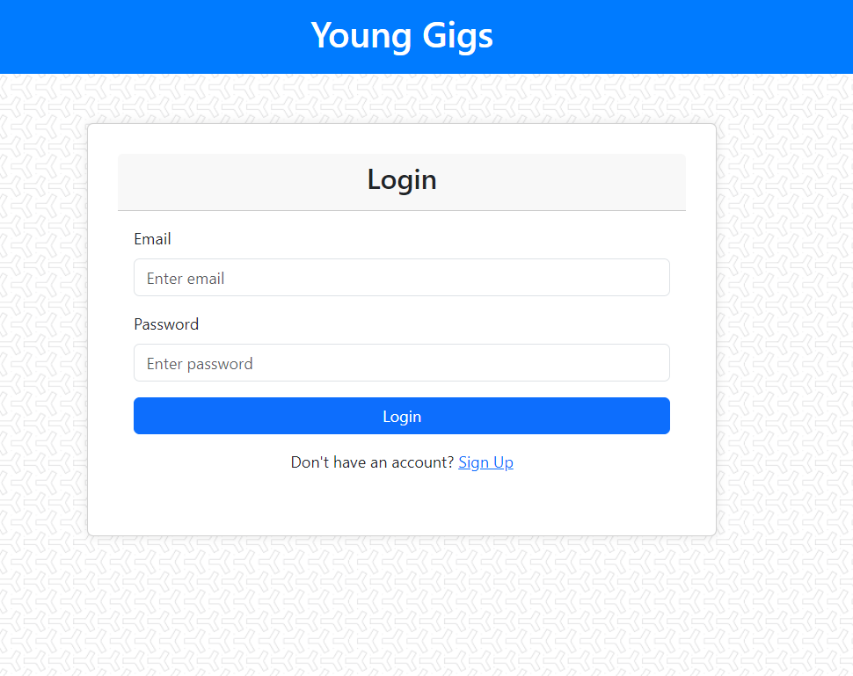
Sign Up page
Our Webpages
Login page

Slide 6
Feature: User Authentication
Login and Signup Pages:
Description: Young Gigs offers a seamless and secure login and signup process for users. Whether you're a job seeker or an employer, you can easily create an account or log in to access the platform's features.
Constraints: To ensure the security of user accounts and data, we've implemented robust constraints for password strength, email verification, and account verification processes.
Benefits: By providing a streamlined authentication process, Young Gigs ensures a frictionless user experience while maintaining the integrity and security of user accounts.

Slide 7
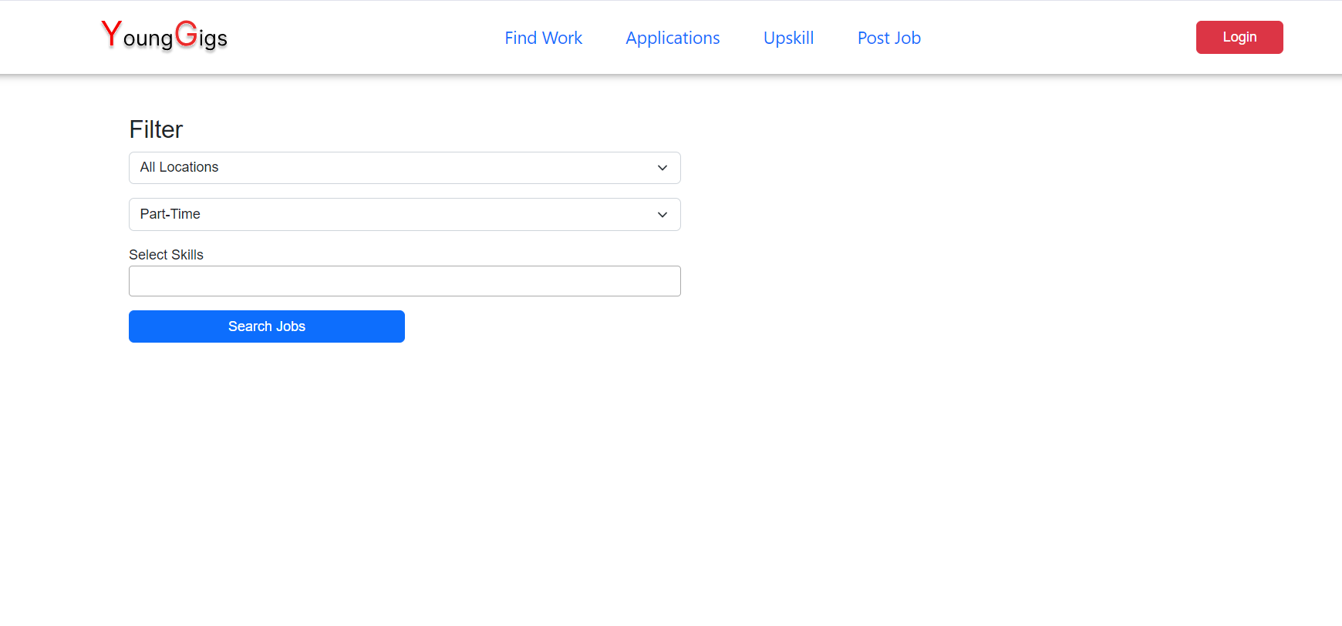
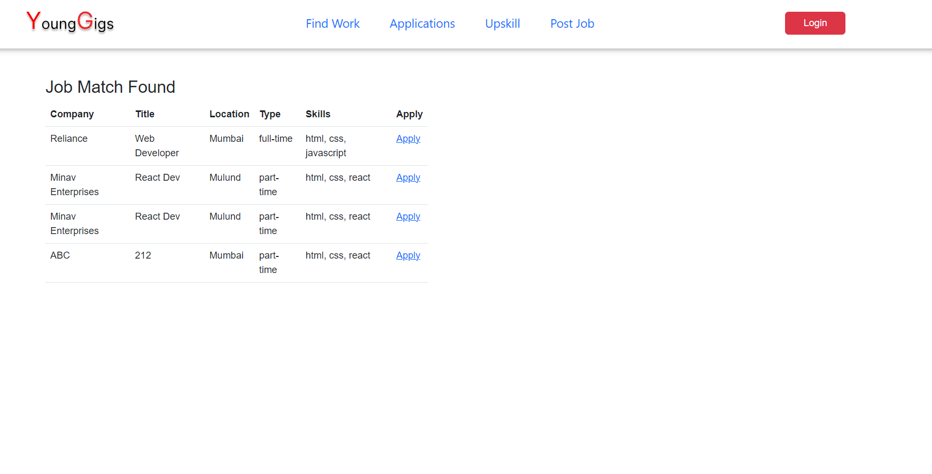
Our Webpages
Find a Job Page

Slide 8
Feature: Job Filtering
Description: Young Gigs offers robust job filtering capabilities, allowing users to tailor their job search based on their preferences and criteria.
Location-Based Filtering: Users can filter job listings by location, enabling them to find opportunities in their desired geographic area or explore remote job opportunities.
Advanced Filters: In addition to location, users can apply advanced filters such as job type (full-time, part-time, freelance), industry, experience level, and more, to refine their search results and focus on relevant job listings.
Benefits: With customizable filtering options, Young Gigs empowers users to find job opportunities that align with their specific needs, preferences, and career goals. Whether you're searching for a job close to home or seeking remote work opportunities, our advanced filtering system makes it easy to find the perfect match.

Slide 9
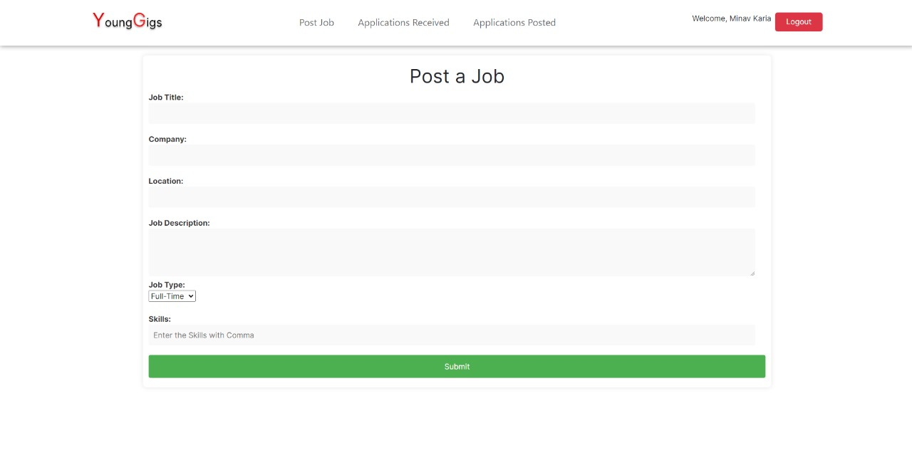

Our Webpages

Slide 10
Feature: Post a Job
The "Post a Job" page on Young Gigs simplifies the process of job posting with its user-friendly interface and intuitive design. Employers can effortlessly navigate through clear instructions and simplified form fields, reducing the time and effort required to create job listings. The platform offers comprehensive fields for entering job details, including title, description, requirements, and location, ensuring a complete overview of the position. Additionally, employers have the flexibility to customize job listings with company branding, logo, and multimedia content to attract top talent. With its efficient and straightforward approach, Young Gigs makes job posting a hassle-free experience for employers, maximizing visibility and engagement with potential candidates.

Slide 11
Skills and Feature’s used
Throughout the development of Young Gigs, our team has leveraged a diverse set of technical skills to bring the platform to life. Here are the key skills utilized:
HTML (HyperText Markup Language): Used to create the structure and layout of web pages, allowing for the organization and presentation of content.
CSS (Cascading Style Sheets): Employed to design and style the visual appearance of the website, including colors, fonts, and layouts, ensuring a visually appealing and consistent user experience.
JavaScript: Implemented to add interactivity and dynamic functionality to the website, enabling features such as real-time updates, form validation, and interactive elements.
PHP (Hypertext Preprocessor): Utilized for server-side scripting, enabling the processing of user inputs, database interactions, and dynamic content generation, ensuring seamless communication between the front-end and back-end components of the platform.
MySQL: Employed as the relational database management system (RDBMS) to store and manage data related to users, job listings, and other essential information, ensuring data integrity and efficient retrieval.

Slide 12
FUTURE IMPROVEMENTS
As we look ahead, it's essential to consider potential enhancements and developments for Young Gigs to further enhance its effectiveness and relevance in the ever-evolving job market. Here are some key areas for future improvements:
Enhanced Matching Algorithms: Implementing advanced algorithms to improve the accuracy of job recommendations based on user preferences, skills, and experience. This will streamline the job search process and ensure better alignment between job seekers and available opportunities.
Diversification of Job Categories: Expanding the range of job categories and industries represented on the platform to cater to a broader spectrum of job seekers. By diversifying the available opportunities, Young Gigs can attract a more diverse user base and better address the varying needs and interests of its users.
Enhanced User Experience (UX) Design: Continuously refining the platform's user interface and experience based on user feedback and usability testing. This includes optimizing navigation, simplifying the application process, and ensuring accessibility across different devices and screen sizes.
.

Slide 13
Conclusion
In conclusion, Young Gigs represents a groundbreaking solution in the realm of job searching, catering specifically to the needs and preferences of the digital generation. Through its innovative features and user-centric approach, Young Gigs has redefined the way young individuals navigate the job market, offering a seamless and empowering experience.
As we move forward, let's continue to embrace the possibilities offered by Young Gigs and work together to shape the future of job hunting for the digital generation.

Slide 14
Thank You!

